Slide 1




EDUGUARD
Presented by TEAM The Tech Tribe

Slide 2

PROBLEM
  Late, Manual Detection
  Manual tracking (attendance & grades)
  Students flagged only after exam failure
  Reactive — no early warning
  Too many students to monitor at scale

Slide 3
HOW SYSTEM WORKS
RANDOM FOREST CLASSIFIER
70 / 30 TRAIN-TEST SPLIT
INPUTS: ACADEMIC, FINANCIAL, ENGAGEMENT
OUTPUTS: DROPOUT PROBABILITY
RISK BUCKETS: LOW · MEDIUM · HIGH
INSTEAD OF RULES, THE SYSTEM LEARNS PATTERNS.
AI makes the decision not fixed rules

Slide 4
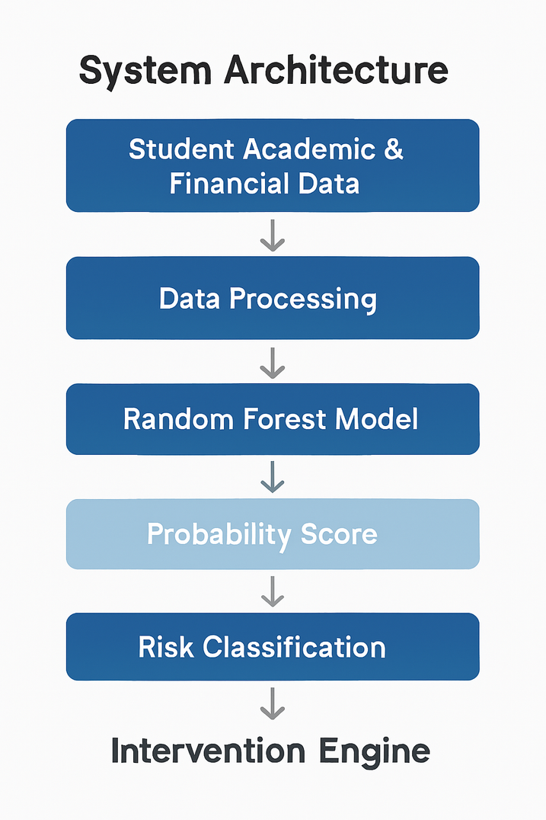
SYSTEM ARCHITECTURE

Slide 5

IMPACT
Supports academic counselors
Helps prioritize students who need help
Can be integrated with LMS systems
Scalable for large institutions

Slide 6

THANK YOU
Presented by
Team The Tech Tribe (TripleT)

